Slide 1
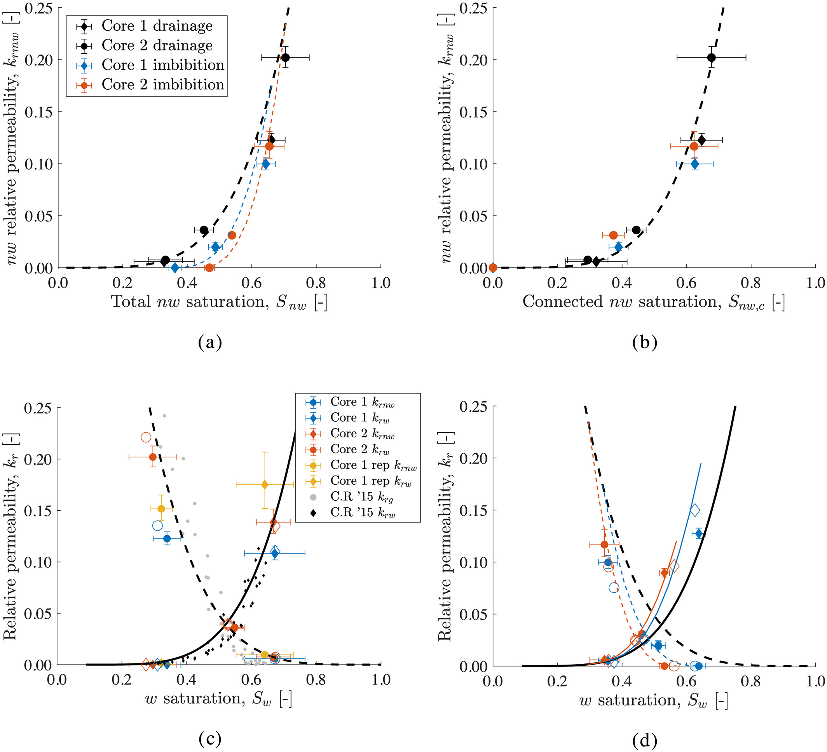
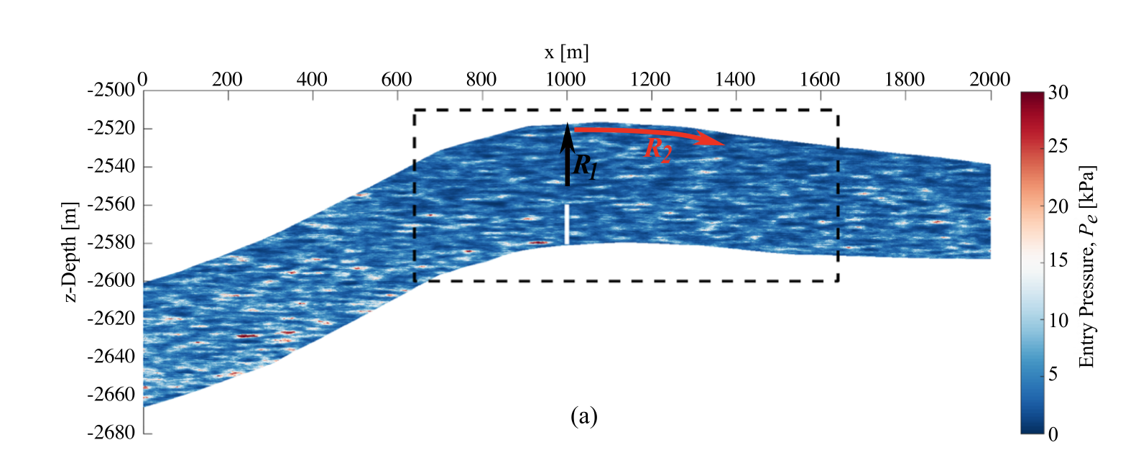
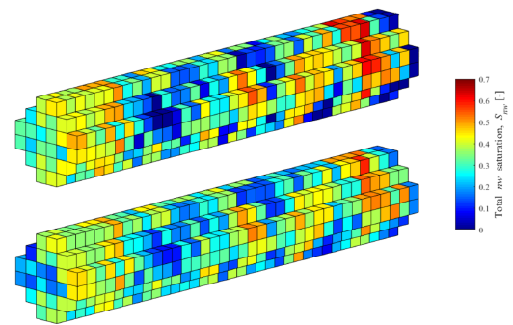
Software demonstration for StrataTrapper
Field scale characterization
Speaker: Senyou An
Investigator: Nele Wenck, Ann Muggeridge, Samuel Krevor (PI)
21/02/2023

Slide 2
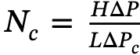
Research background of StrataTrapper project
The viscous or buoyant terms dominate at spatial scales of order 1 m and greater. Capillary pressure gradients can be ignored over field scales because they contribute little to fluid movement.
The establishment of equilibrium in capillary pressure over small length scales in heterogeneous rocks has a significant impact on the local fluid mobility.
Dimensionless capillary number
Challenge: Most of approaches overlook a key impact that small-scale heterogeneity in capillary pressure characteristics can have on large-scale plume migration.

Slide 3
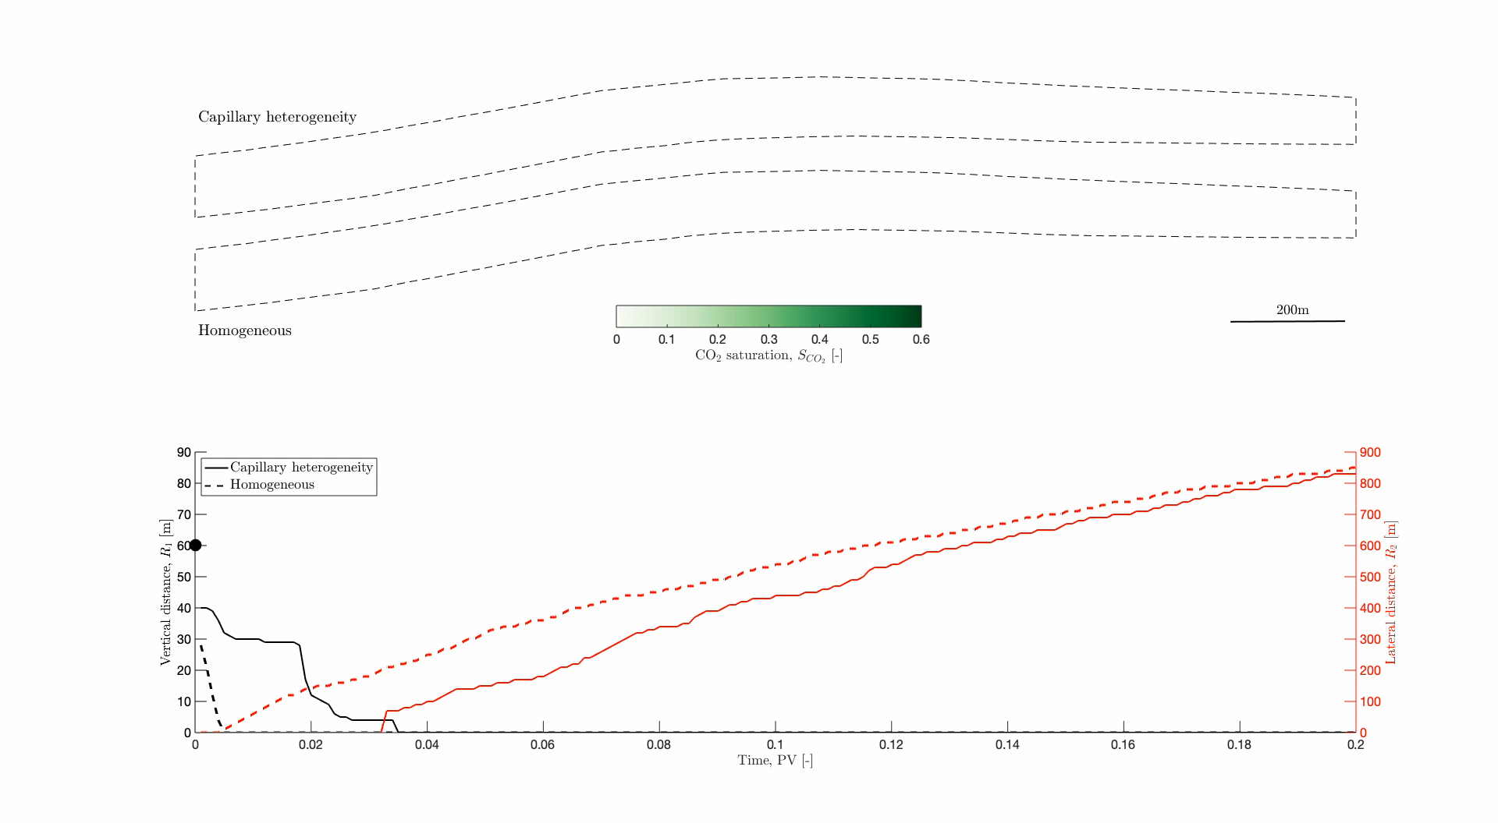
Research background in 2D simulation domain

Slide 4
Milestones of StrataTrapper
Summary of Milestones and Deliverables
Ref | Title | Responsibility | Due Date (Mo)
M1.1 | Codes for reservoir characterisation are created and tested | ICL | 6
M1.2 | Codes for flow function generation are created and tested | ICL | 12
D1.1 | Open source research codes for the characterisation of multiphase flow heterogeneity and conversion to flow functions for reservoir simulation | ICL | 18
D1.2 | A report detailing the workflows for reservoir characterisation, and model creation and use | ICL | 18

Slide 5
Flowchart of 3D field-scale characterization
Reservoir architecture
Setting correlation length in three coordinates
Meshing & Homogenizing
Petrophysical parameters
Legend
Generating correlated field
External input
Structured mesh
Statical porosity distribution
Subroutine
Porosity distribution
Data
Porosity-permeability relation
Permeability distribution
Output
Capillary pressure relation
Upscaling
Pe distribution
Brooks corey equation & Chierici function
Capillary pressure curve Relative permeability curve
in each cell
Output 3D field-scale model

Slide 6
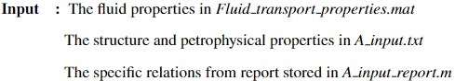
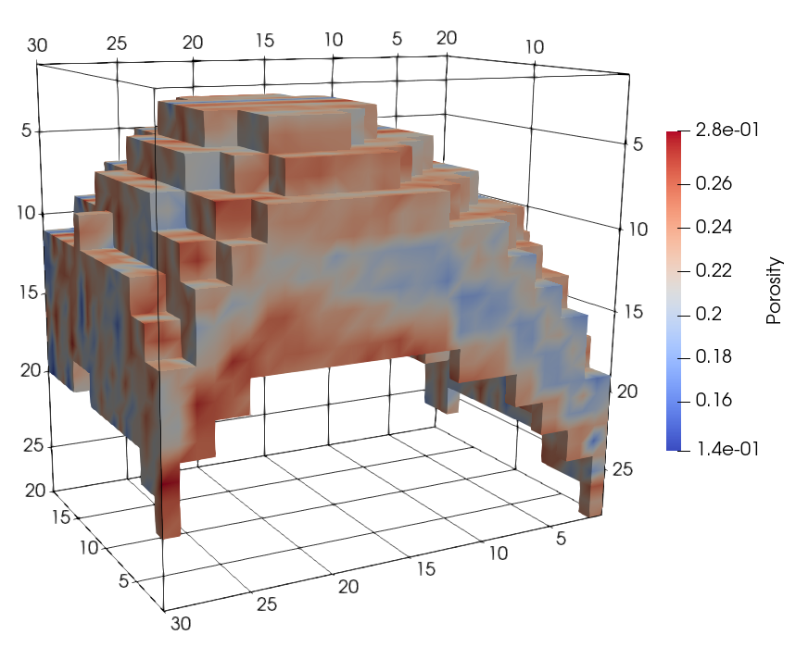
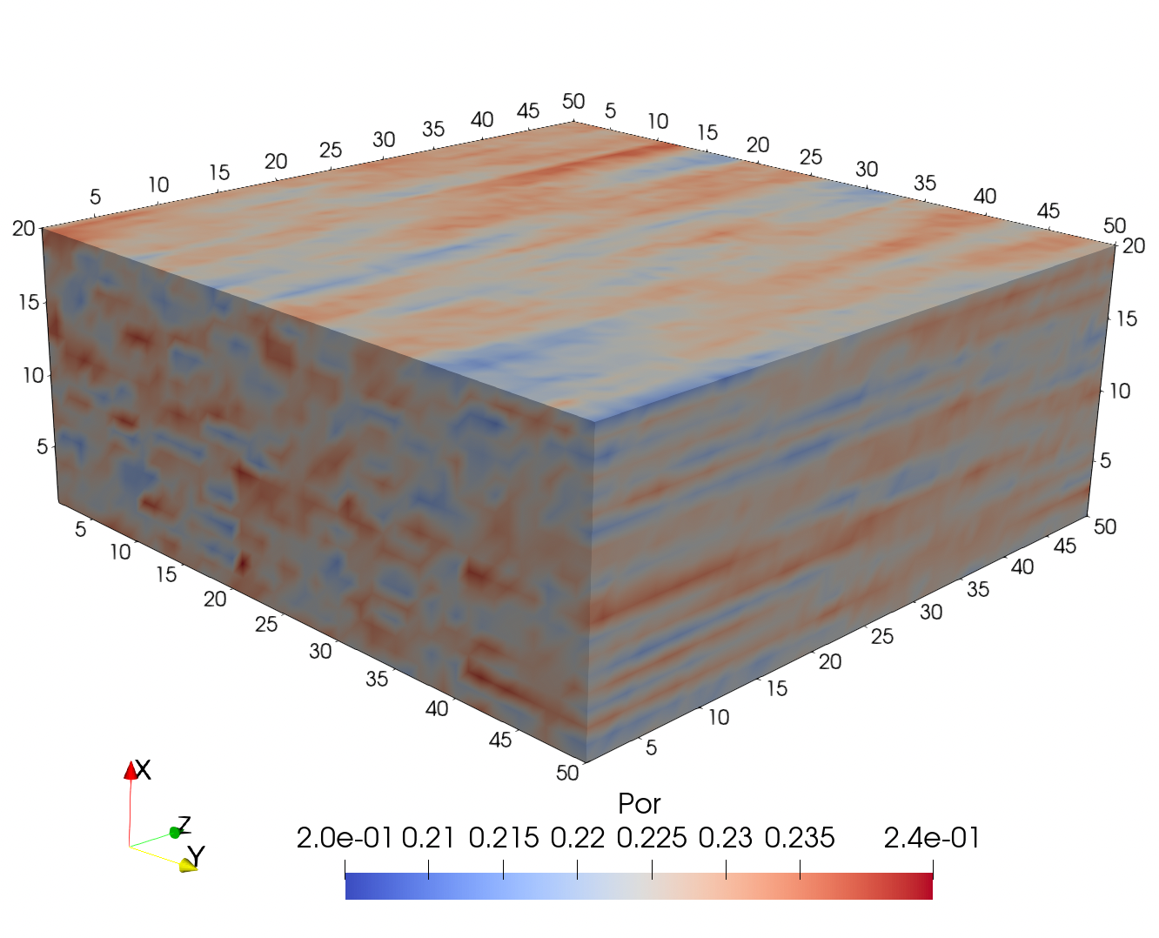
Generate correlated porosity field in fine-scale grid
Load reservoir & petrophysical properties. Define upscaling, and do the interpolation. A1_1_Generate global parameters .m
Generate the correlated porosity field (Figure. 1) in the fine-scale grid. A2 _1_Generate data structure fine.m
Polygon transect fitting to reveal on-site geo-structure. A2 _1_ Generate shift structure fine2.m
Fine-scale grid
Correlation length (0, 10, 2) m
Mean porosity (mu): 0.228
(10, 10, 10) m
Variation (sigma): 0.02

Slide 7
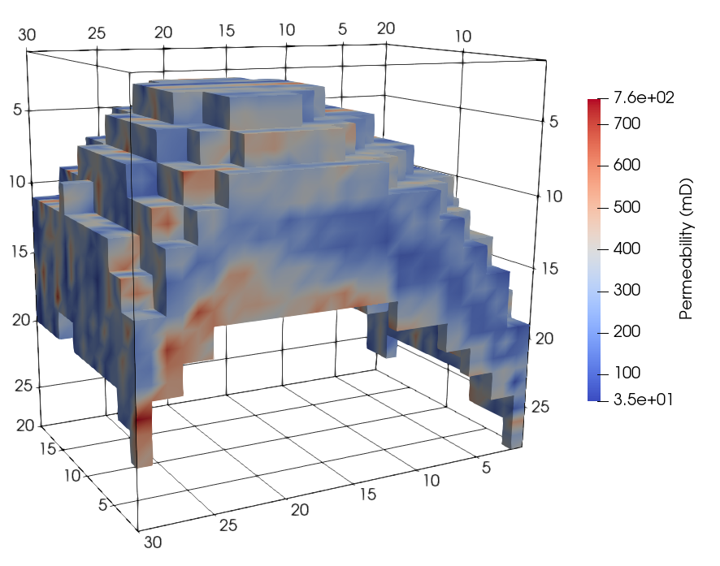
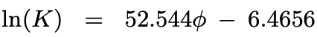
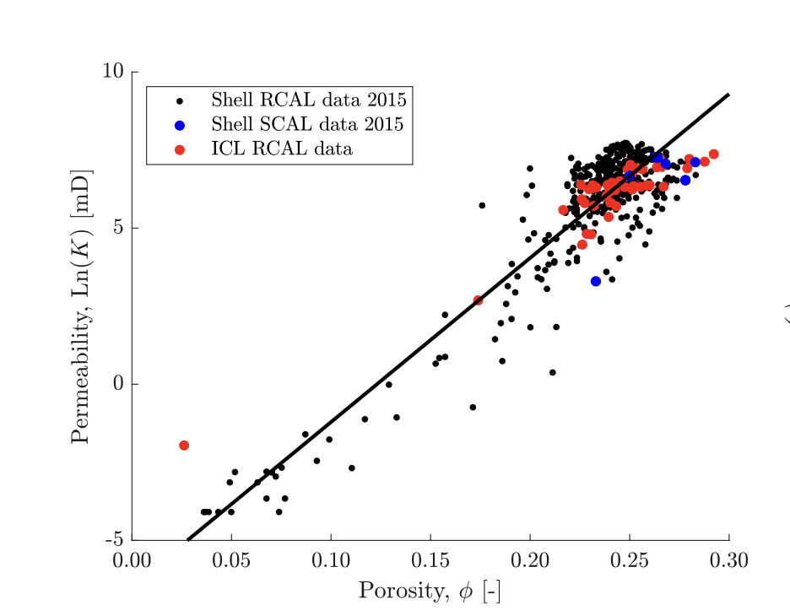
Correlated permeability field in fine-scale grid
Goldeneye field, North Sea, UK
Correlated absolute permeability is calculated the based on the porosity distribution. A2_1_Generate data structure fine.m

Slide 8
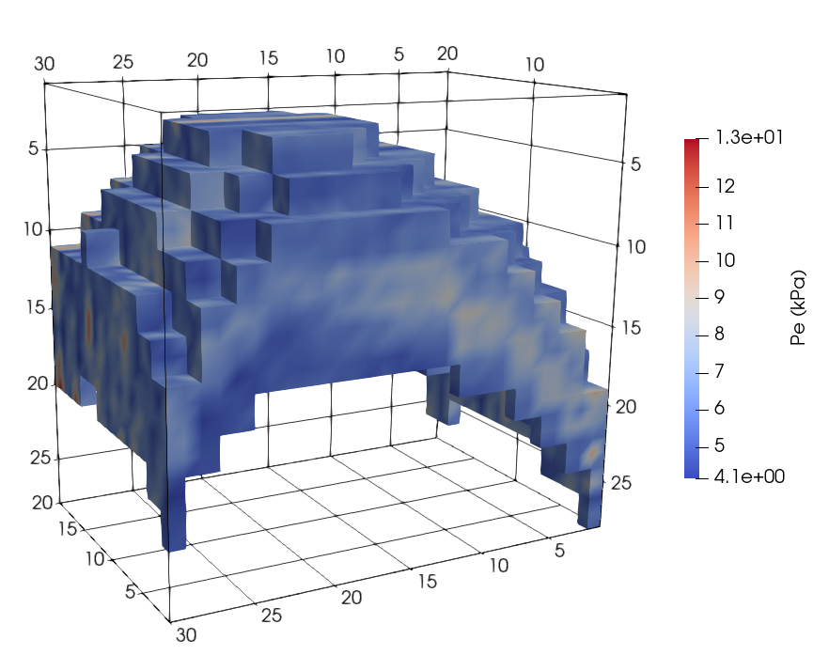
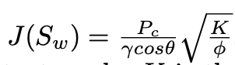
Correlated entry capillary pressure field
The entry capillary pressure field is derived using the Leverett-J function. A2_1_Generate data structure fine.m

Slide 9
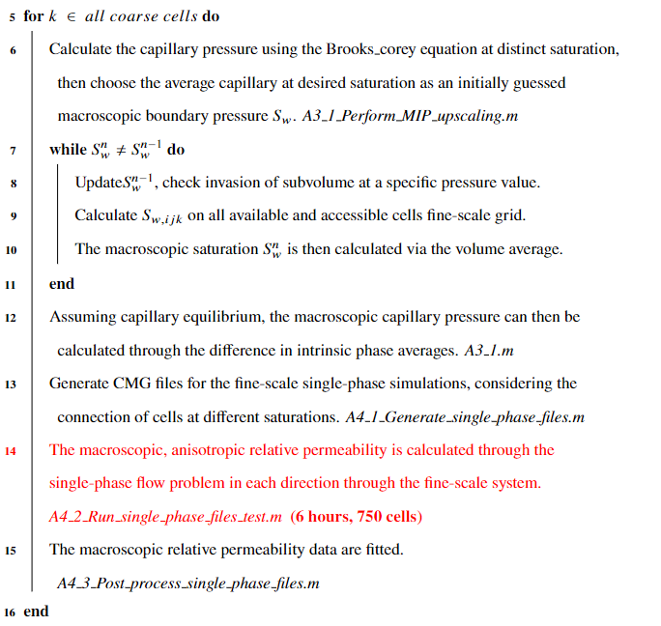
Correlated capillary pressure curve and relative perm

Slide 10
Upscaled capillary pressure curve in each block
Upscaled Pc
based on connection
Notes:
Perform Macroscopic Invasion Percolation (MIP) to obtain the upscaled capillary pressure at decreasing water saturations 𝑆𝑤,𝑎𝑖𝑚: Calculate the capillary pressure, 𝑃𝑐 using the Brooks-Corey equation at each 𝑆𝑤,𝑎𝑖𝑚, using the average entry pressure in the coarse cell. 𝑆𝑤,𝑎𝑖𝑚 is obtained by splitting the saturation range into 40 equal increments, starting from 𝑆𝑤 = 1. Use 𝑃𝑐 as the initial guess for the macroscopic boundary pressure, 𝑃𝑏. The local system is invaded with non-wetting phase at the applied 𝑃𝑏 starting from the boundary cells and working inwards. A fine-scale cell is invaded if 1) it is connected to a cell which is connected to the boundary and 2) 𝑃𝑏 is greater than the cell’s entry pressure. Once all accessible cells are invaded, calculate the upscaled 𝑆𝑤 (the fine-scale saturation distribution is inverted from the fine-scale capillary pressure distribution. The upscaled saturation is then calculated via volume averaging).

Slide 11
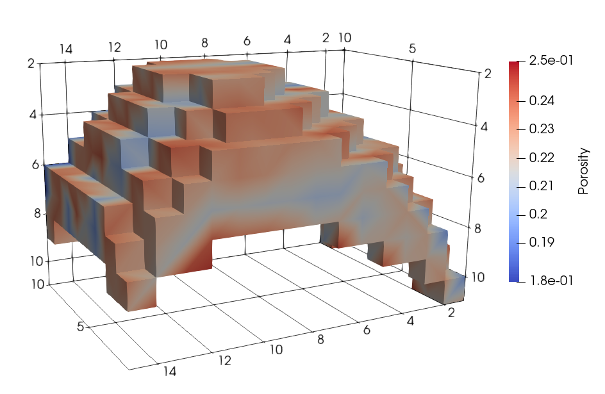
Upscaled correlated porosity
Upscaled porosity field in the coarsen grid
2 times in each direction
Fine grid size (10,20,30)
Upscaled size (5, 10, 15)

Slide 12
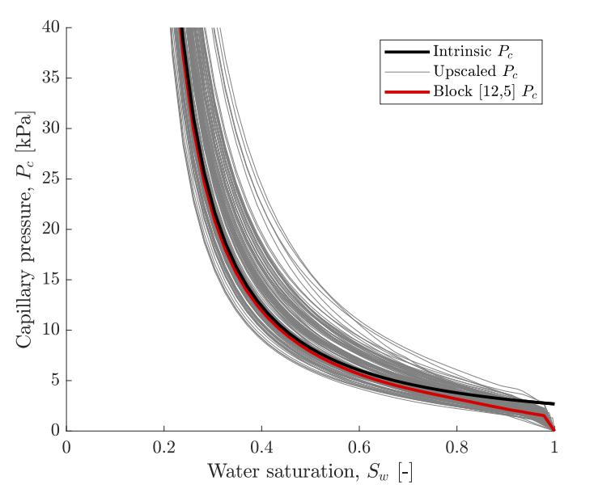
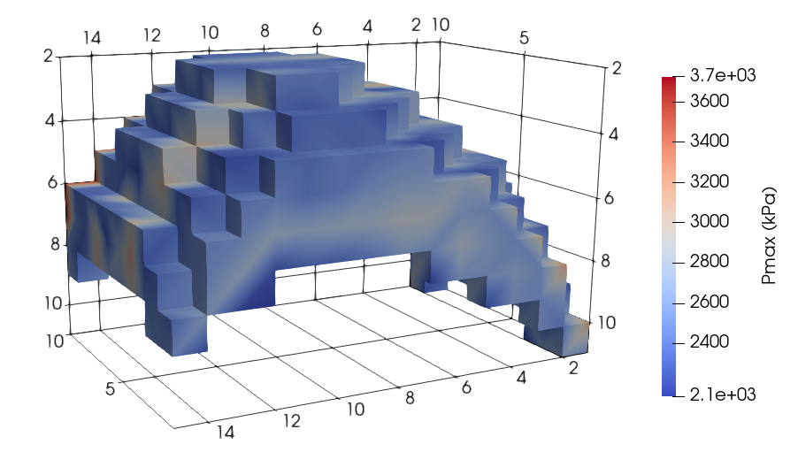
Upscaled capillary pressure curve for each block

Slide 13
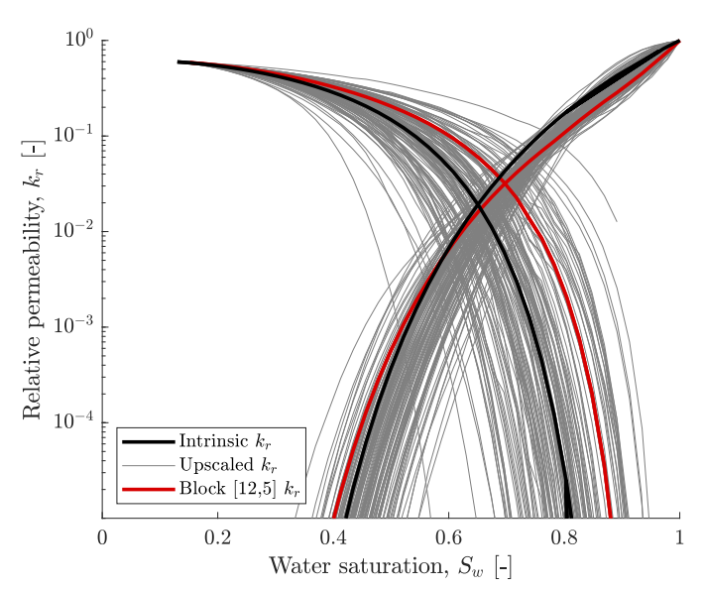
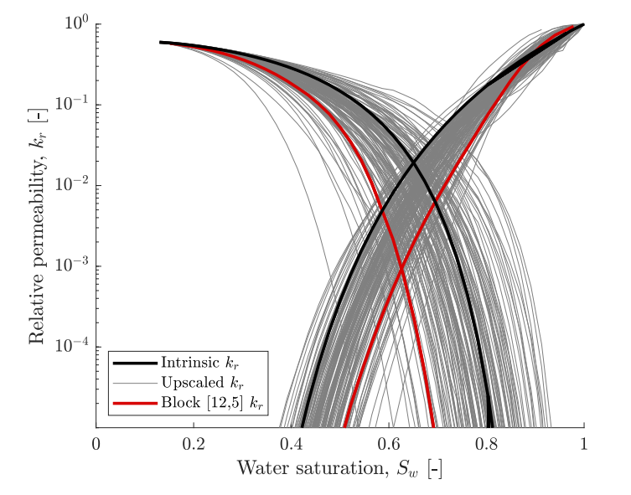
Upscaled relative permeability for each block
0
Sw_aim
1

Slide 14
Final simulation result for two-phase flow
Two-phase flow

Slide 15
Software demonstration
Field scale characterization
Thanks for you listening!
Look forward to discussing with you!
Further information?
Sam Krevor: s.krevor@imperial.ac.uk
Nele Wenck: nele.wenck15@imperial.ac.uk
Senyou An: s.an@imperial.ac.uk
21/02/2023

